Slide 1
Web Development Nanodegree
Session 3
Conducted by: Hamza

Slide 2
agenda
CRUD
Migration
Relationships
Breakout rooms [activity 1]
Breakout rooms [activity 2]

Slide 3
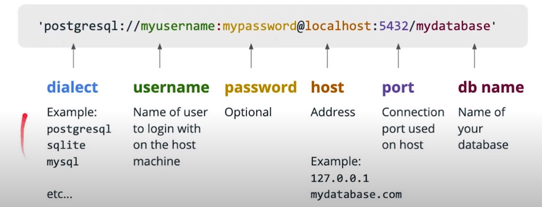

Slide 4
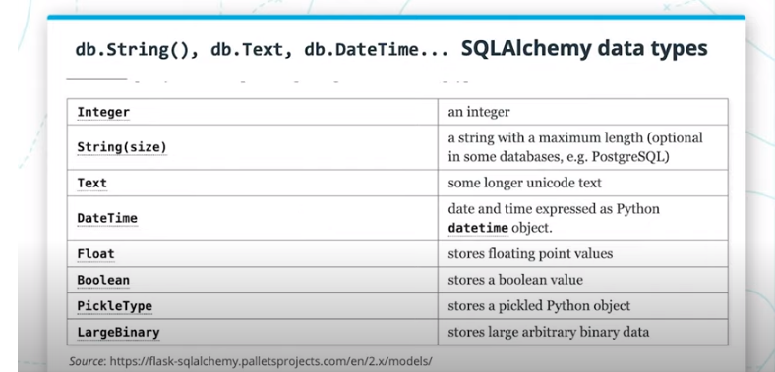
Sqlalchemy data types
Notes:
https://www.datacamp.com/community/tutorials/pickle-python-tutorial
pickle type .. map python objects as binary data and then returning them as python objects later
What is pickling?
Pickle is used for serializing and de-serializing Python object structures, also called marshalling or flattening. Serialization refers to the process of converting an object in memory to a byte stream that can be stored on disk or sent over a network. Later on, this character stream can then be retrieved and de-serialized back to a Python object. Pickling is not to be confused with compression! The former is the conversion of an object from one representation (data in Random Access Memory (RAM)) to another (text on disk), while the latter is the process of encoding data with fewer bits, in order to save disk space.
What Can You Do With pickle?
Pickling is useful for applications where you need some degree of persistency in your data. Your program's state data can be saved to disk, so you can continue working on it later on. It can also be used to send data over a Transmission Control Protocol (TCP) or socket connection, or to store python objects in a database. Pickle is very useful for when you're working with machine learning algorithms, where you want to save them to be able to make new predictions at a later time, without having to rewrite everything or train the model all over again.
When Not To Use pickle
If you want to use data across different programming languages, pickle is not recommended. Its protocol is specific to Python, thus, cross-language compatibility is not guaranteed. The same holds for different versions of Python itself. Unpickling a file that was pickled in a different version of Python may not always work properly, so you have to make sure that you're using the same version and perform an update if necessary. You should also try not to unpickle data from an untrusted source. Malicious code inside the file might be executed upon unpickling.
A Binary Large OBject (BLOB) is a collection of binary data stored as a single entity in a database management system. Blobs are typically images, audio or other multimedia objects, though sometimes binary executable code is stored as a blob. Database support for blobs is not universal.

Slide 5
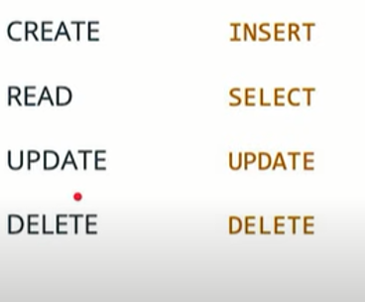
Crud
Notes:
Considering thinking of a more difficult question, as this is a question already in udacity quizzes

Slide 6
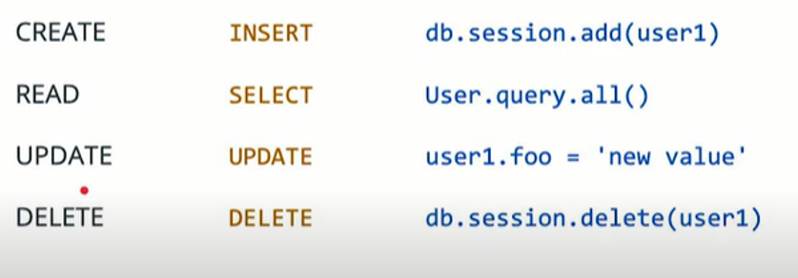
Body??
ID??
Notes:
When does rollback doesn’t work after flush ?
When does db.session.delete work ?
Persistent or pending?
I mean if u create an object and added it, u should use rollback instead (pending)
But if u are accessing an item from database (persistent), then u should use delete.
Which request would need a body ? Post/ put / patch
Which request would require searching for an object ? Thus needs an I. Get/put/delete

Slide 7
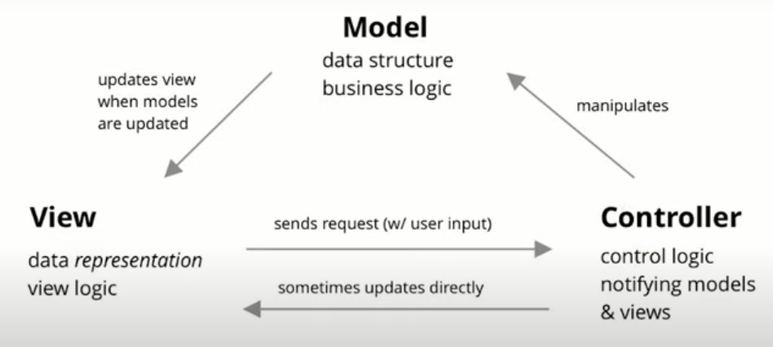

Slide 8

Create account
Notes:
What should be implemented in frontend and what should the user see ?
What validation?
What happens in controller and how to interact with the database
How output is rendered in HTML and what should be implemented and what should the user see
Consider modifying this idea to include how to debug based on MVC pattern?
For each item, how do we get user data? URL form, json ? Json if using fetch

Slide 9
DELete from cart
fetch
Notes:
Delete is waiting for a success statement

Slide 10
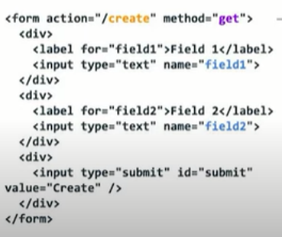
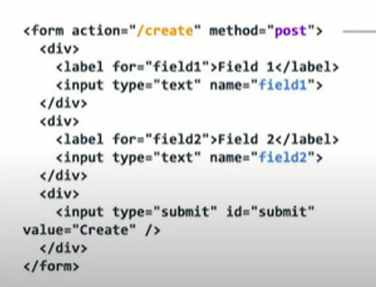
Notes:
Then how can I get these?
Get is handled by URL query
Post is handled by form or json
Get is used for few inputs

Slide 11
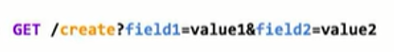
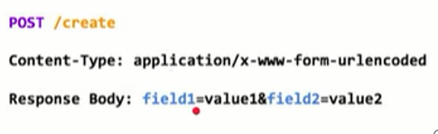
Notes:
Msh faker eh elso2al

Slide 12
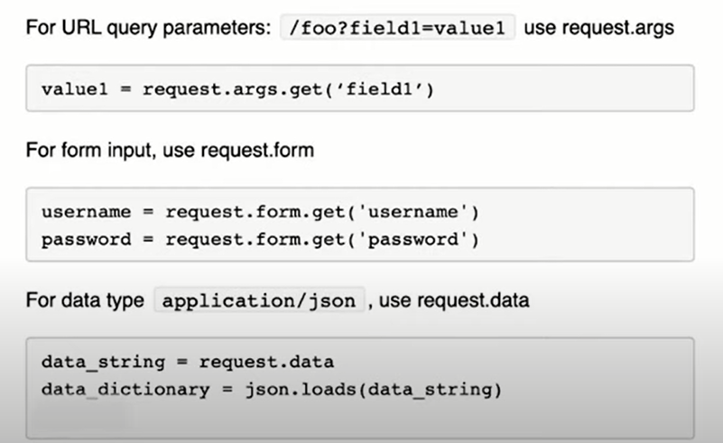
Any better alternatives
Notes:
Args is an object
U can pass default string as a second parameter to get method
Consider adding scenario or using request and response from web dev 2nd edition
Avoid request.form.get_json()
What is data_string ? I think I is json string
From what is written, what does loads do ?
Json loads vs json dumps vs jsonify
What is json.stringify? Is it because json is a string ?

Slide 13
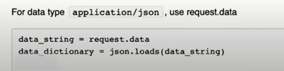
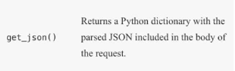
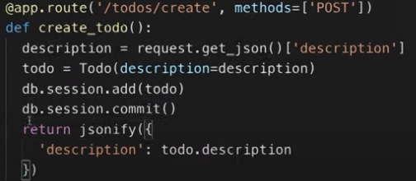
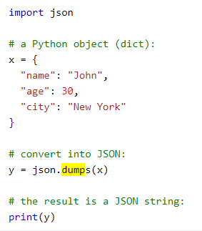
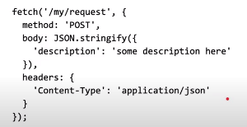
add json dumps
Notes:
Why do we send jsonify ?
We want the flavor of dictionary, but dictionaries are data types in python. Json is the closest relevant
https://campus.datacamp.com/courses/intermediate-importing-data-in-python/interacting-with-apis-to-import-data-from-the-web-2?ex=8
Also add datacamp link for free 2 months

Slide 14


Slide 15
We don’t need jsonify anymore
miguel post

Slide 16
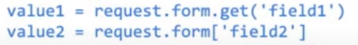
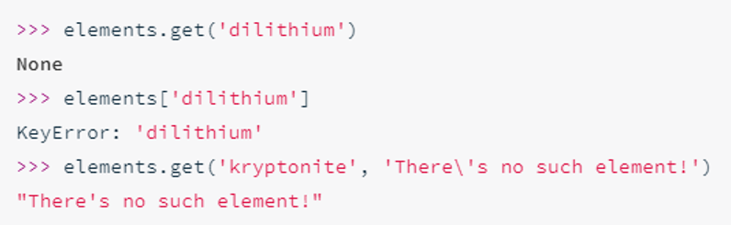
Notes:
U can treat form as a dictionary or use get method on it.
I think if it is treated as a dictionary, it will get an error if no entry is present

Slide 17
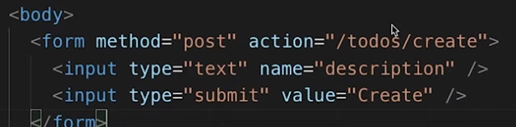
Most accurate ?
Notes:
Nope
U are specifying post request
On a todo, this would mean to create a todo intuitively
Also naming convention for routes is to have names

Slide 18
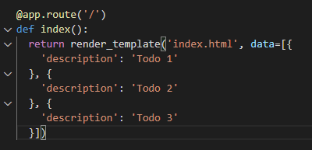
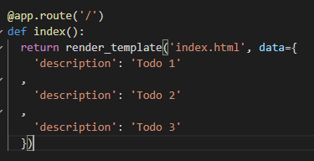
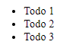

Jinja
For loop in jinja
Notes:
Which endpoint gives which result and why ?
Why can’t I loop over the dictionary?
U can loop in dictionary, but u need unique keys
What about dict.items() ?
Not working because of duplicate keys. In databases, the keys are always duplicates ( column name)
What’s the output of query.all() ➔ list where u can accept the attributes through for loops (list comprehension) or seriailization.

Slide 19
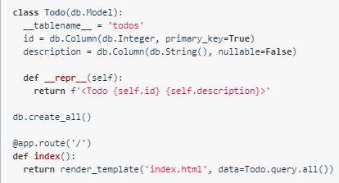
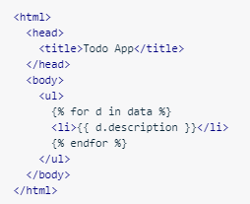
Remove venue and replace it
Notes:
Query.all(0 gives what ?
List of objects
What’s the output of query.all() ➔ list where u can accept the attributes through for loops (list comprehension) or seriailization.
For d in the list of objects, attribute is shown through d.description

Slide 20
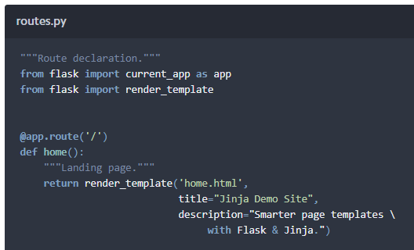
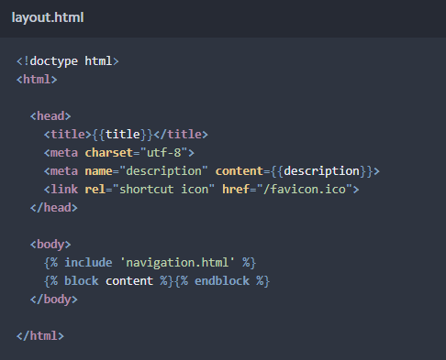
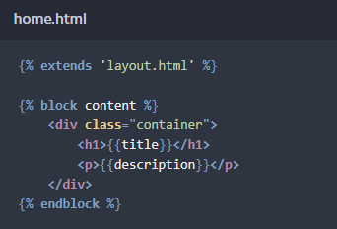
Jinja templates
Notes:
How can this be useful ?
https://hackersandslackers.com/flask-jinja-templates
The link is perfect, however it has some bad words..

Slide 21
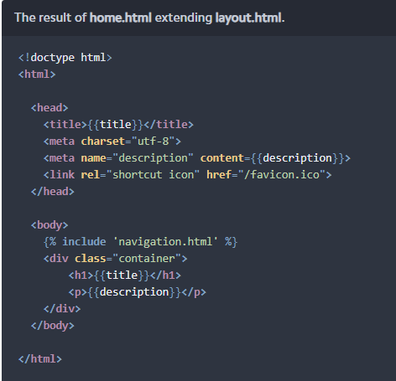
Notes:
Now, can u imagine how useful is it ?

Slide 22
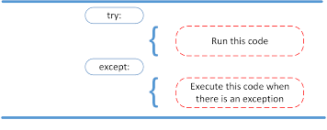
Try except block

Slide 23
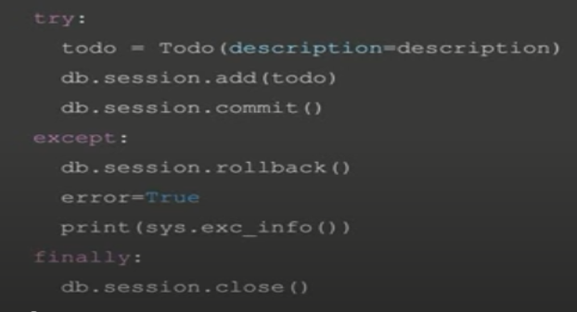
Why bother?
Notes:
https://stackoverflow.com/questions/11551996/why-do-we-need-the-finally-clause-in-python
https://www.engyrus.com/2015/03/spt-4-there-is-no-try.html
Prob: try except will hide errors
To avoid this, print(sys.exc_info) or exception
Why do we need try except …?
To avoid system crash on errors
Also, When u close the session, pending changes are automatically committed. On sudden closure, this maybe a big problem maybe I am wrong
Maybe without electricity outage, tahneega bas, mmken yeb2a feeh 7agat pending
Maybe in try I added an object to pending, then I had an error in a second object addition
If I didn’t allow rollback, then maybe the first pending object gets commited by db.session.close()
Db.session.close is imp due to housekeeping to connection pool, this is best practice
I moved return jsonify after finally because I was afraid that session wont close if I returned before it
When I return class.attribute as todo.description in finally, it doesn’t work because todo is empty after session add and commit and session close(due to expire on commit)
When does the object disappear?
Also it is important to return connections to connection pool, why is that ?

Slide 24
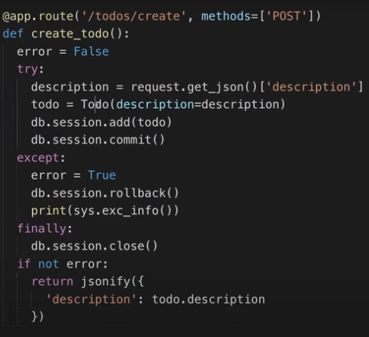
What’s wrong?

Slide 26
Notes:
Todo object is not available anymore

Slide 27
Notes:
What side effects can occur?

Slide 28
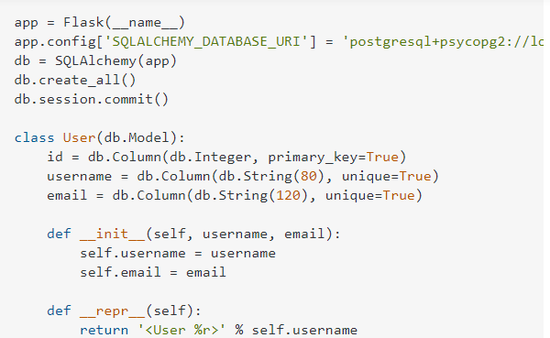
What’s the problem ?
How to access the user table in psql?
Notes:
First scenario, table not created

Slide 29
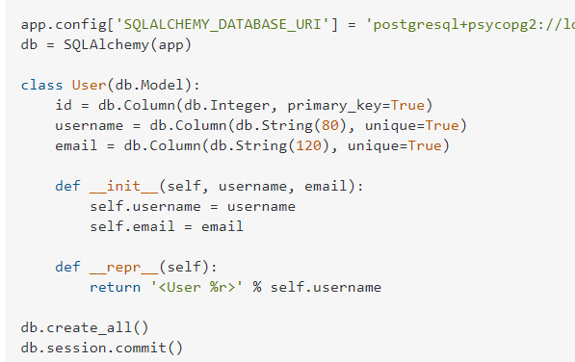
solution
Notes:
https://stackoverflow.com/questions/20744277/sqlalchemy-create-all-does-not-create-tables

Slide 30
Db.create_all()
Why limited ?
Notes:
https://stackoverflow.com/questions/34807235/why-sqlalchemy-create-all-can-be-reused
create_all indeed creates only tables that do not exist. It is not intended for migrations but to create the initial structure in an empty database.
You want alembic for migrations, possibly via Flask-Migrate
Besides that, having any database structure related code in the web-facing part of your Flask app is questionable. Usually you do such things in a command-line tool (via Flask-Script or click), e.g. python manage.py create_db.
I disagree with your opinion of "poorly implemented". It's rather implemented in a way that stops you from doing the wrong (and possibly dangerous) thing. Imagine you rename a column. A ""smart"" create_all would DROP the old column (it's gone after all) and create a new one - it's impossibly for any tool to know that you renamed it instead of removing and adding one.
With migrations:
Auto-detects changes from the old version & new version of the SQLAlchemy models
Creates a migration script that resolves differences between the old & new versions
Gives fine-grain control to change existing tables
This is much better, because
We can keep existing schema structures, only modifying what needs to be modified
We can keep existing data
We isolate units of change in migration scripts that we can roll back to a “safe” db state

Slide 31
Then why not ?
Notes:
For version control

Slide 32

migration
Notes:
When will db init fail ?

Slide 33
migration
Notes:
When will db init fail ?

Slide 34

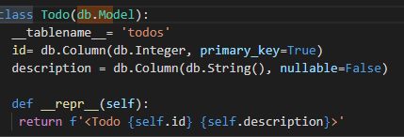

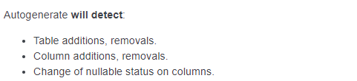
Migration limitation
Alembic is currently unable to detect table name changes, column name changes
Notes:
What can I change in the table and be detected by migration ?
This can save hours
Alembic is currently unable to detect table name changes, column name changes, or anonymously named constraints.

Slide 35
How to solve this error?
Notes:
https://stackoverflow.com/questions/58405883/flask-sqlalchemy-add-nullable-false-column-to-existing-table-with-data

Slide 36
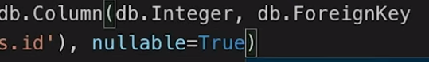
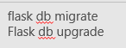
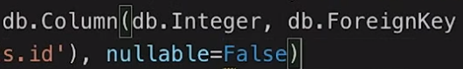
Solution 1
Notes:
If I created the column in psql and populated it with data, I think migration would override it and delete the data

Slide 37
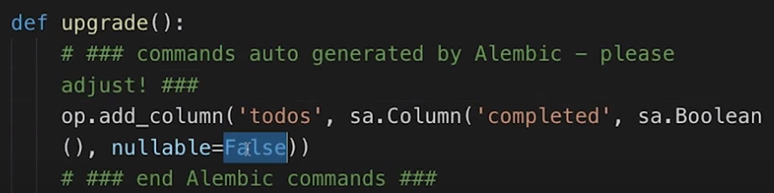
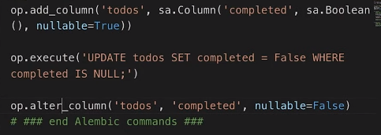
Solution 2
Notes:
Modify the first alembic version to the following

Slide 38
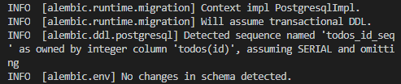
Adding flask-migrate to an existing project
https://blog.miguelgrinberg.com/post/how-to-add-flask-migrate-to-an-existing-project
Notes:
No error, but why does this appear ?
It compares model.py with the database.
If u have taken a working database, nothing would be detected, as db is already finished
Solution:
Create a temp db, make initial migration then connect to the new db and migrate again

Slide 39
Tables and relationships
Employee ID
First name
Second name
payID
Hourly rate
Notes:
https://database.guide/the-3-types-of-relationships-in-database-design/

Slide 40
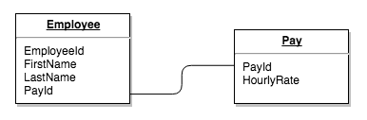
Notes:
In the above example, we could just as easily have put an HourlyRate field straight into the Employee table and not bothered with the Pay table. However, hourly rate could be sensitive data that only certain database users should see.

Slide 41
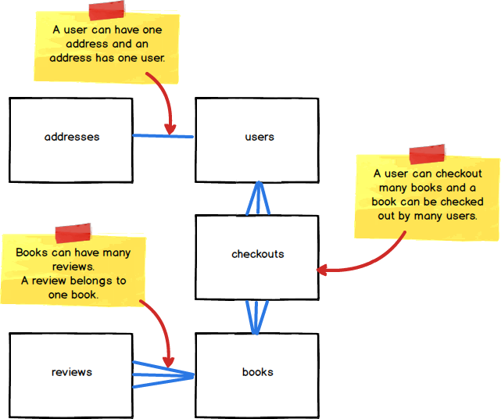
relationships

Slide 42
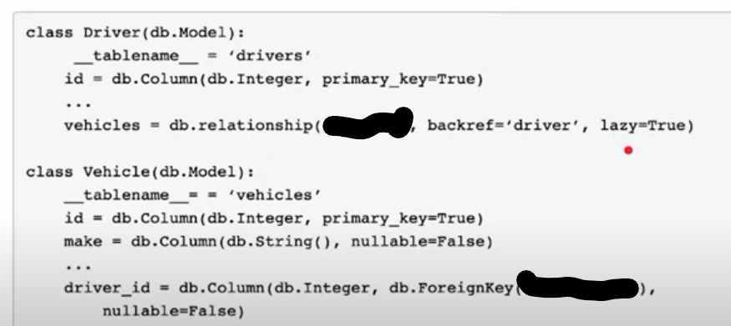
ONE TO MANY
Notes:
Foreign key uses the name of the class. Here drivers
Relationship uses the name of the class
Here we have the vehicles “plural” in the Driver table., As one driver can have many vehicles
However, in backref, we have a driver, because vehicles are linked to a single driver

Slide 43
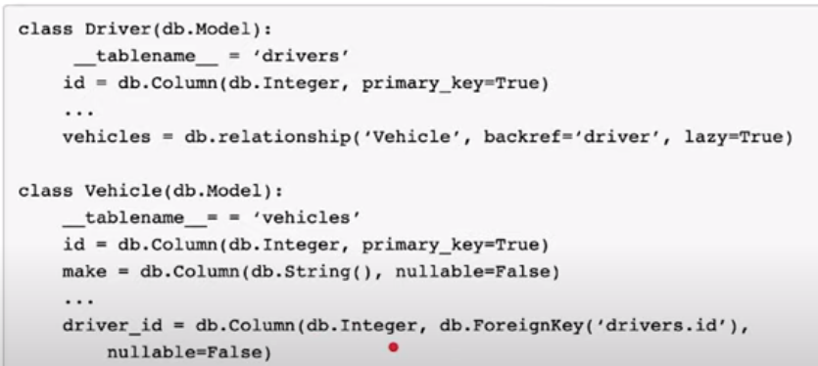
solution

Slide 44
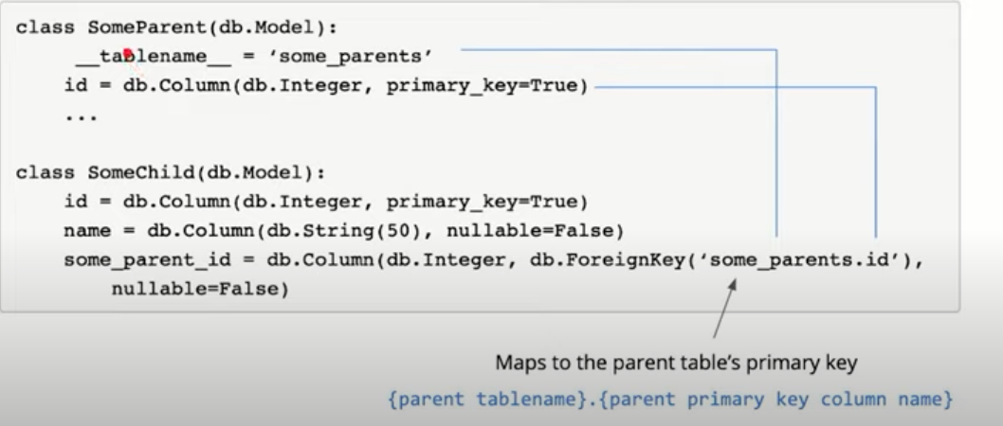
CLASS vs table_name

Slide 45
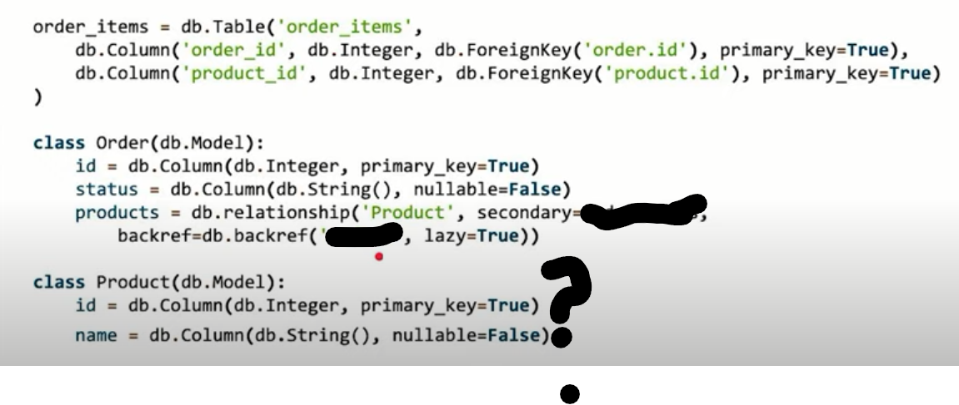
Many to many
Notes:
Primary key here, are they a must?

Slide 46
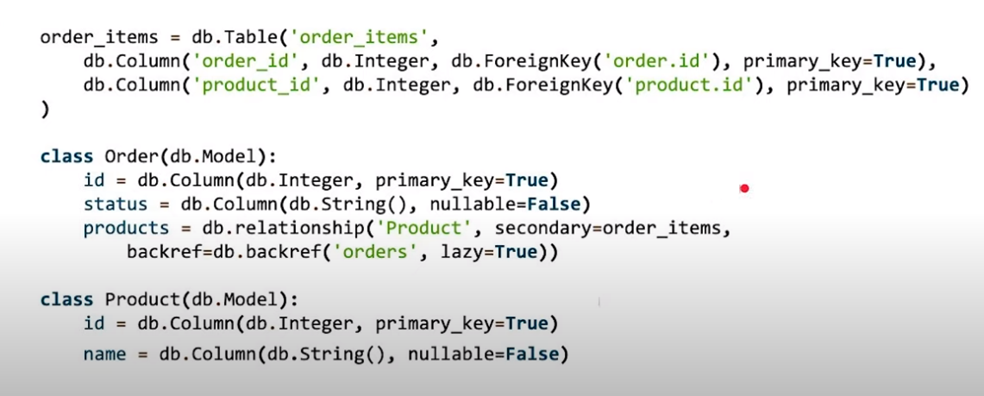

Slide 47
One to one?
Breakout room ☺

Slide 48
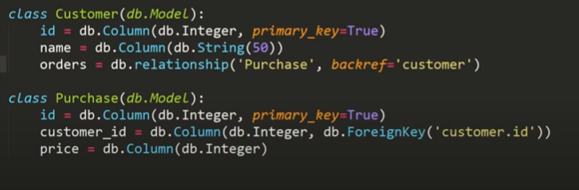
join

Slide 49
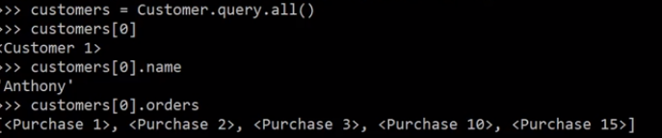
All at once

Slide 50
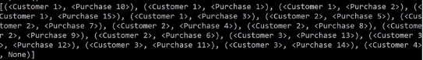
solution
What type?

Slide 51

what’s the output ?
Notes:
Name:

Slide 52


Slide 53



cascade
Save/update vs all vs all,delete orphan
Notes:
What happens to addresses when we add user1 to session ?
Addressess are added automatically
If u explain session in the beginning, u will know what is session and what happens when u add items to it
https://docs.sqlalchemy.org/en/13/orm/cascades.html

Slide 54



Deleting an account

Slide 55


Delete under Save update option
Notes:
Here only the relation(key) between address and user will be None, but address won’t be deleted

Slide 56



delete
Notes:
delete cascade on one-to-many relationships is often combined with delete-orphan cascade, which will emit a DELETE for the related row if the “child” object is deassociated from the parent. The combination of delete and delete-orphan cascade covers both situations where SQLAlchemy has to decide between setting a foreign key column to NULL versus deleting the row entirely.

Slide 57

Delete vs delete orphan
Notes:
Delete orphan deletes the child if it is disconnected from the parent, even before parent deletion
The delete cascade indicates that when a “parent” object is marked for deletion, its related “child” objects should also be marked for deletion.
delete-orphan cascade adds behavior to the delete cascade, such that a child object will be marked for deletion when it is de-associated from the parent, not just when the parent is marked for deletion.
delete-orphan cascade implies that each child object can only have one parent at a time, and in the vast majority of cases is configured only on a one-to-many relationship. For the much less common case of setting it on a many-to-one or many-to-many relationship, the “many” side can be forced to allow only a single object at a time by configuring the relationship.single_parent argument, which establishes Python-side validation that ensures the object is associated with only one parent at a time, however this greatly limits the functionality of the “many” relationship and is usually not what’s desired.
https://docs.sqlalchemy.org/en/13/orm/cascades.html#backref-cascade

Slide 58


loading
Notes:
https://docs.sqlalchemy.org/en/14/orm/loading_relationships.html
The loading of relationships falls into three categories; lazy loading, eager loading, and no loading.
lazy loading - available via lazy='select' or the lazyload() option,
joined loading - available via lazy='joined' or the joinedload()
subquery loading - available via lazy='subquery' or the subqueryload() option,
select IN loading - available via lazy='selectin'
raise loading - available via lazy='raise', lazy='raise_on_sql‘
no loading - available via lazy='noload', or the noload() option;

Slide 59
Questions and feedback

Slide 60
Thank you

